Slide 1
Deformable 3D Representation Learning for Articulated Objects
Xiao Sun
July 2022

Slide 2
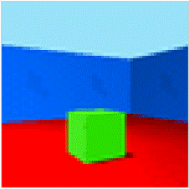

Background: Inverse Graphics
Inverse Graphics: analyze an image by attempting to synthesize it with compact graphics codes.
Graphics codes
Pose
Light
Shape
.
.
.
Encoder
Decoder
Input image
(De-rendering)
(Rendering)
Synthetic image

Slide 3
Background: Inverse Graphics
Inverse Graphics: analyze an image by attempting to synthesize it with compact graphics codes.
Architecture: variational autoencoder
Variable: graphics code (pose, shape, ...)
Rendering: convolutional Layers
Disentangle: stop gradient BP of other variables
Graphics codes
Pose
Light
Shape
.
.
.
Encoder
Decoder
Input image
(De-rendering)
(Rendering)
Synthetic image
Kulkarni, Tejas D., et al. "Deep convolutional inverse graphics network." Advances in neural information processing systems 28 (2015).

Slide 4
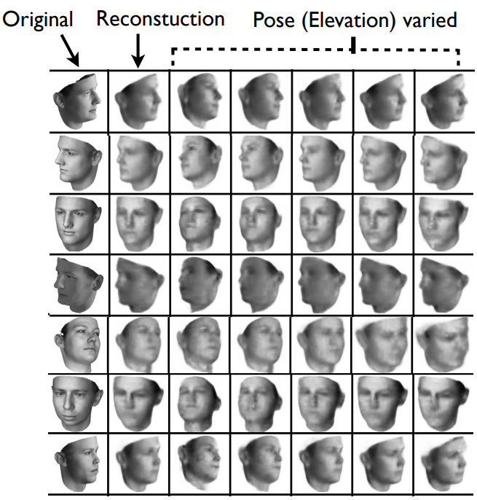
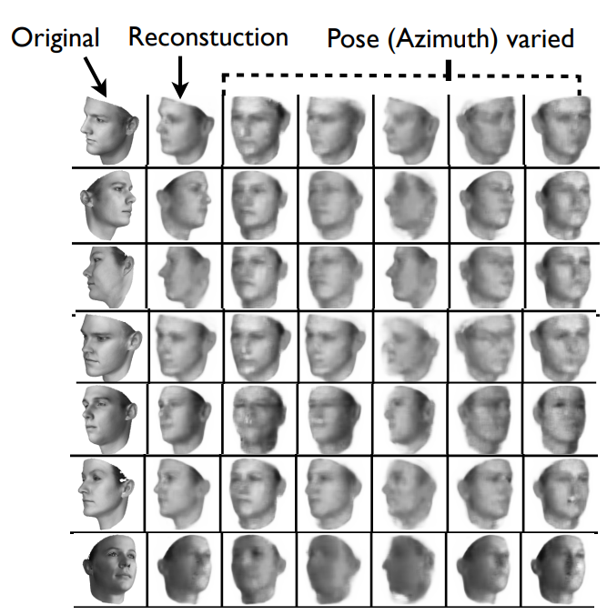
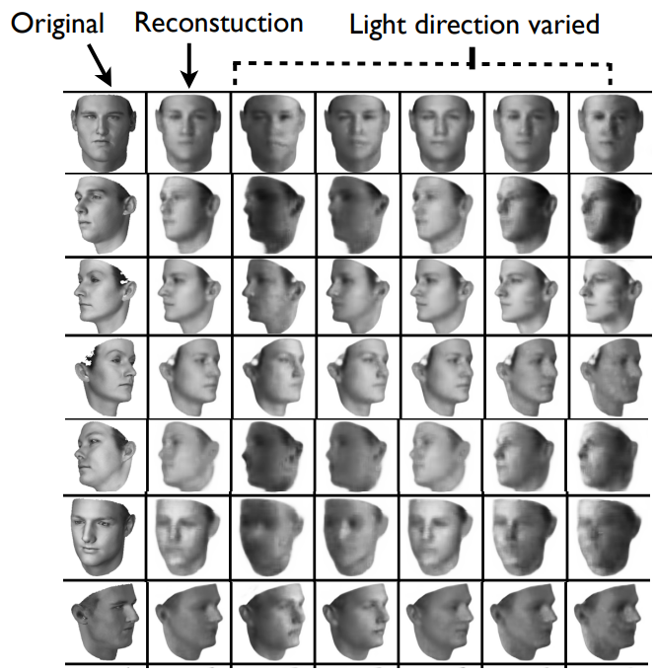
Manipulating pose and light variables
Kulkarni, Tejas D., et al. "Deep convolutional inverse graphics network." Advances in neural information processing systems 28 (2015).

Slide 5

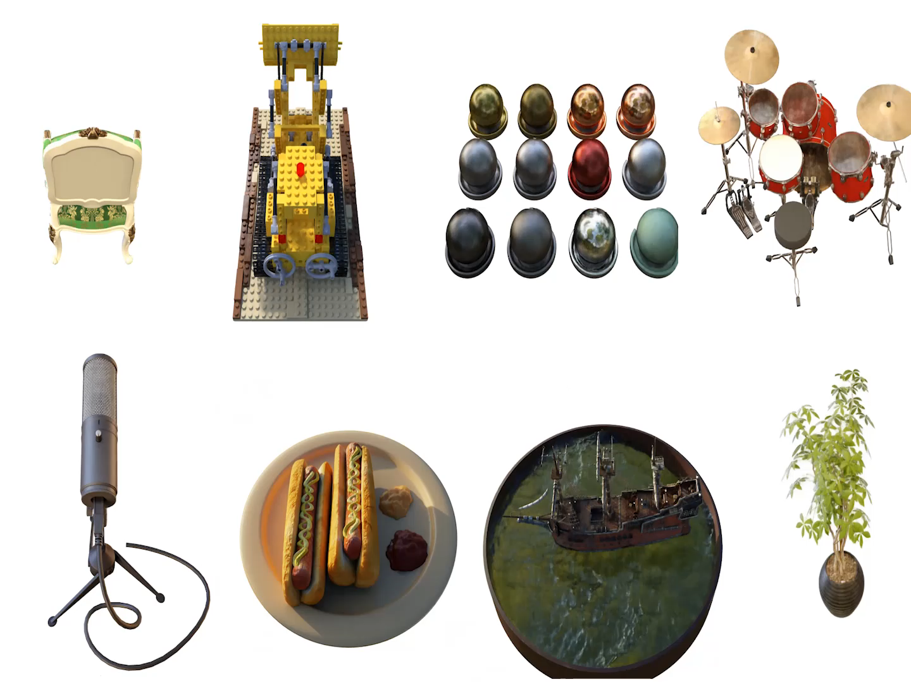
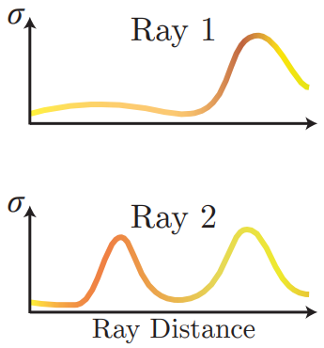
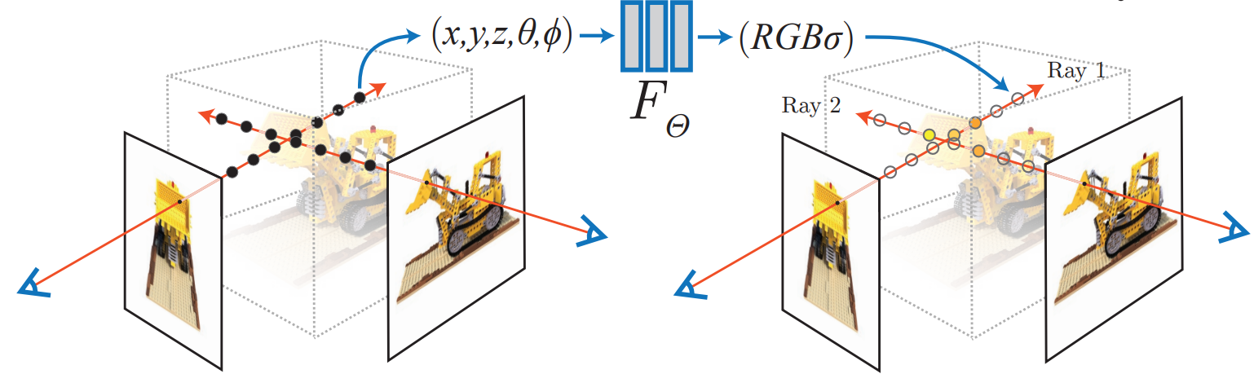
Breakthrough: Neural Radiance Field
Graphics codes
More graphics codes for humans:
* Camera pose
* 3D human pose (deformable)
* Shape parameters like bone length
* Appearance change
Pose
Light
Shape
…
Encoder
Decoder
Input image
(De-rendering)
(Rendering)
Synthetic image
Implicit radiance field (densities and colors of 3D voxels) representation
Differentiable volume rendering
Camera Pose
Mildenhall, Ben, et al. "Nerf: Representing scenes as neural radiance fields for view synthesis."
European conference on computer vision. Springer, Cham, 2020.

Slide 6
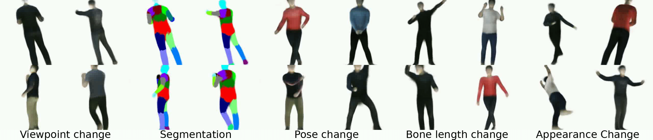
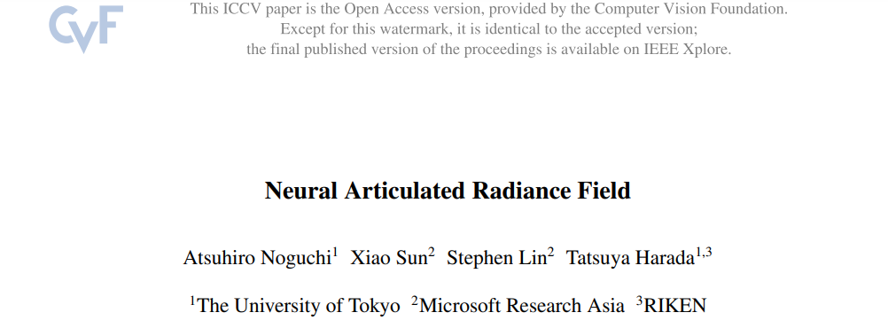
Neural Articulated Radiance Field
Neural Radiance Field + Volume Rendering => Static Object (Scene)
NeRF + Rigid Transform Field + VR => Deformable Articulated Object
It learns disentangled representation of camera viewpoint, bone shape parameters, and bone pose, allowing these properties to be individually controlled in rendering.

Slide 7
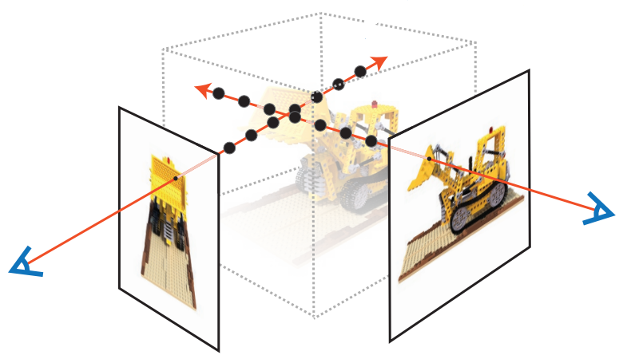
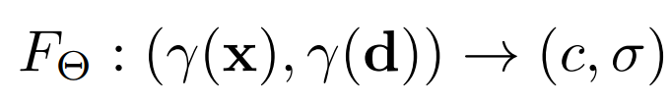
Approach: Vanilla NeRF
x: global 3D location
d: camera view direction
Density and color of x under d,
x, d, {l^{i}}
RGBσ
F(Θ)

Slide 8
Baseline: Pose-Conditioned NeRF
x: global 3D location
d: camera view direction
{l^{i}}: kinematic parameters
Density and color of x under d,
conditioned on pose config {l^{i}}
x, d, {l^{i}}
RGBσ
, {l^{i}}
F(Θ)
Establish dependency between the radiance field and pose, but:
Implicit Transformations
Part Dependency
Kinematic model:

Slide 9
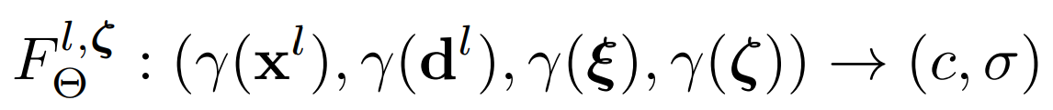
Key Component: Rigidly Transformed NeRF
x^{l}: local 3D location
d^{l}: local view direction
ε,ζ: shape and trans params
Density and color of x under d,
in the local coordinate system
,ε,ζ
RGBσ
x^{l},d^{l}
bone1
bone2
Global
deformable
global coordinate
F(Θ)
local coordinate
Local
static
local
global
RT-NeRF1
RT-NeRF2
RT-NeRF: deformable in global, static in local!

Slide 10
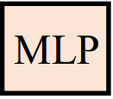
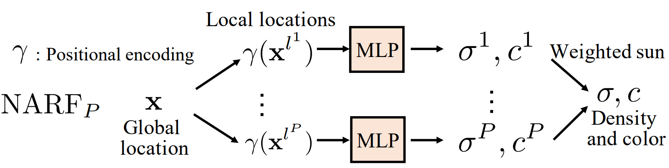
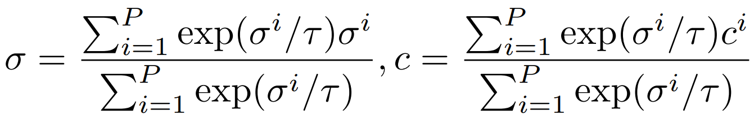
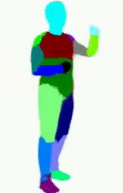
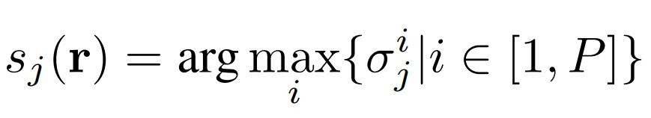
Part-Wise NARF: A Combination of RT-NeRFs
A Rigidly Transformed NeRF for a body part.
0.8
…
0.1
Inefficiency:
Computational cost is proportional to the number of object parts.
Training is dominated by a large number of zero density point samples.

Slide 11
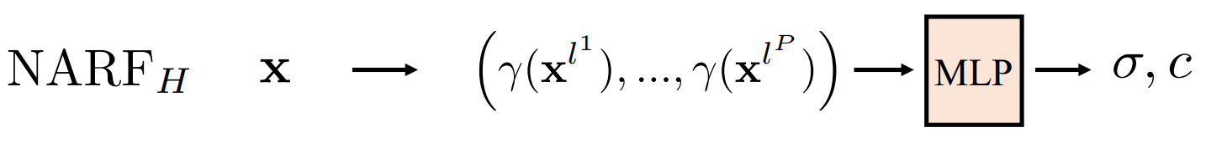
Holistic NARF: Use a Single NeRF Model
The computational cost is almost constant to the number of object parts and the zero density problem is naturally avoided. However, unlike Part-Wise NARF, Holistic NARF does not satisfy Part Dependency, because all parameters are considered for each 3D location.

Slide 12
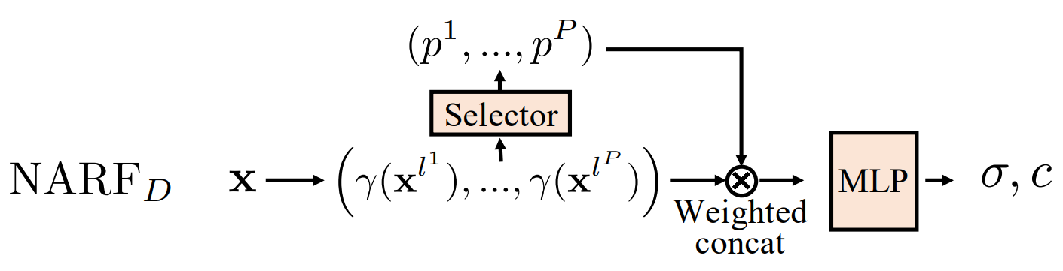
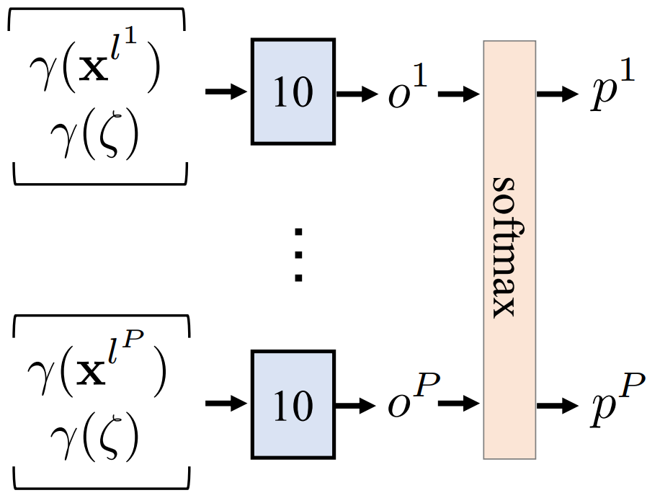
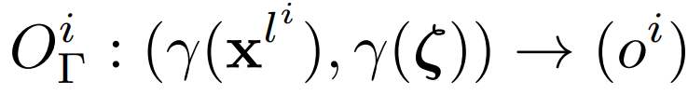
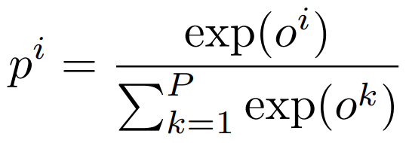
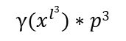
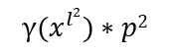
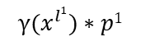
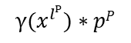
Disentangled NARF: Final Solution
Selector is a lightweight “Part-wise NARF” that identifies which object part a global 3D location x belongs to.
Weighted concatenation: Different bones are distinguished by the dimensions of the concatenated vector that represent them, similar to part identity encoding.
. . .
$${γ(x}^{l1})∗p1$$
$${γ(x}^{l2})∗p2$$
$${γ(x}^{l3})∗p3$$
$${γ(x}^{lP})∗pP$$
0.1
0.0
0.8
0.1

Slide 13
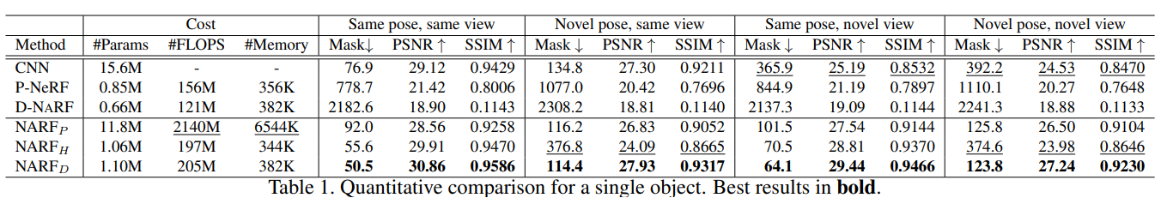
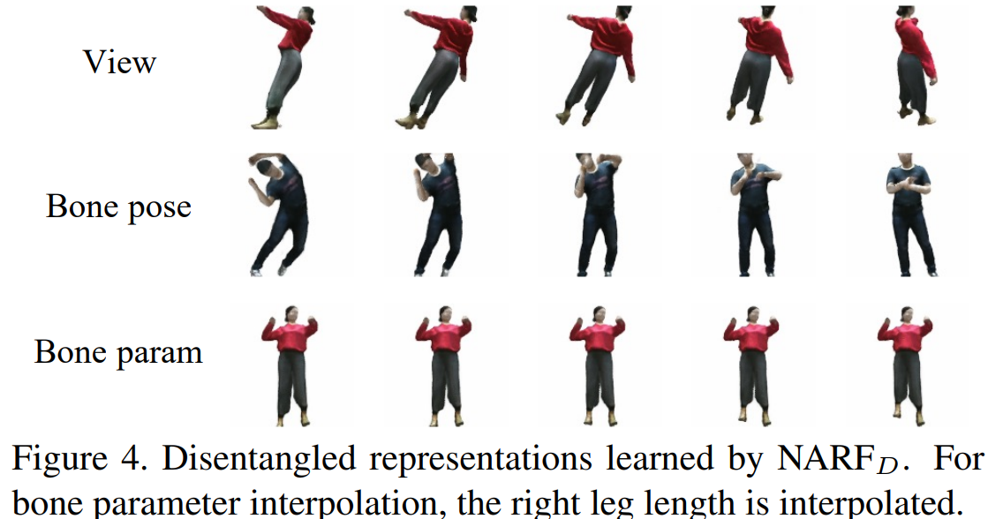
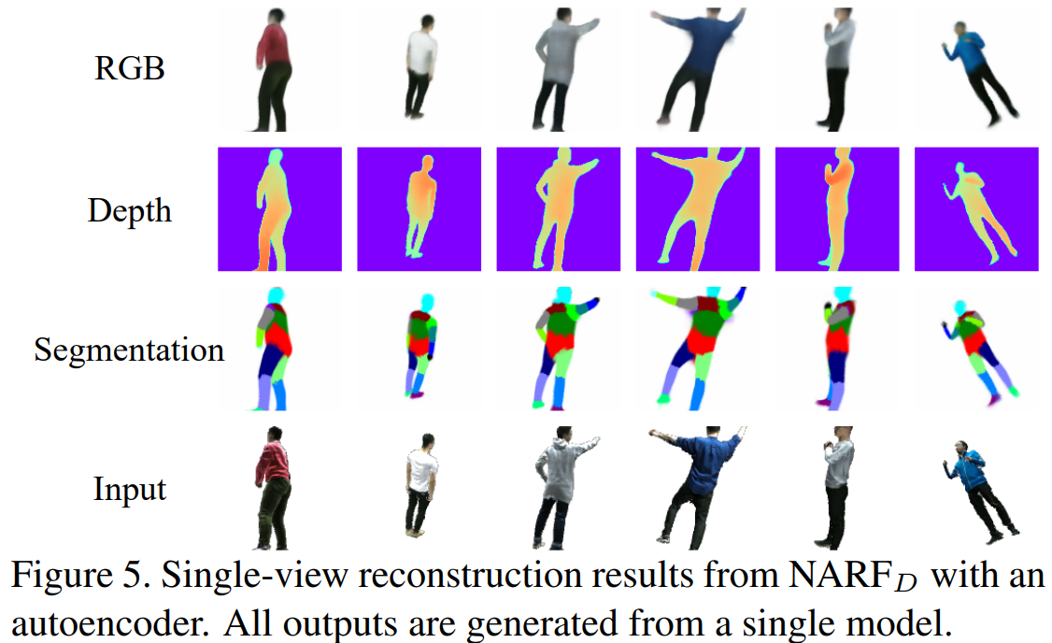
Results

Slide 14
Conclusion and Limitation
Conclusion:
NARF effectively learns deformable 3D representation for articulated objects, allowing for explicit control over viewpoint, pose, bone parameters and appearance from 3D pose annotated images.
Limitation:
Need paired (3D human) pose-image data.
Assume local rigid parts are static.
Global appearance variation only.
Efficiency.

Slide 15
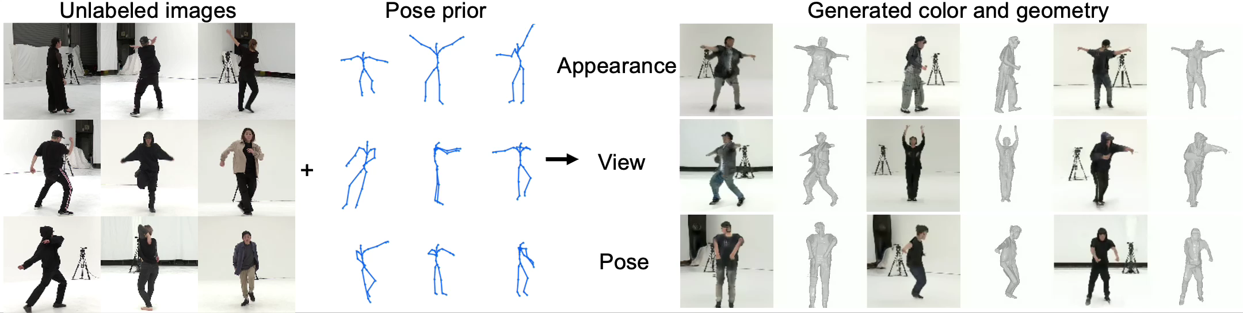
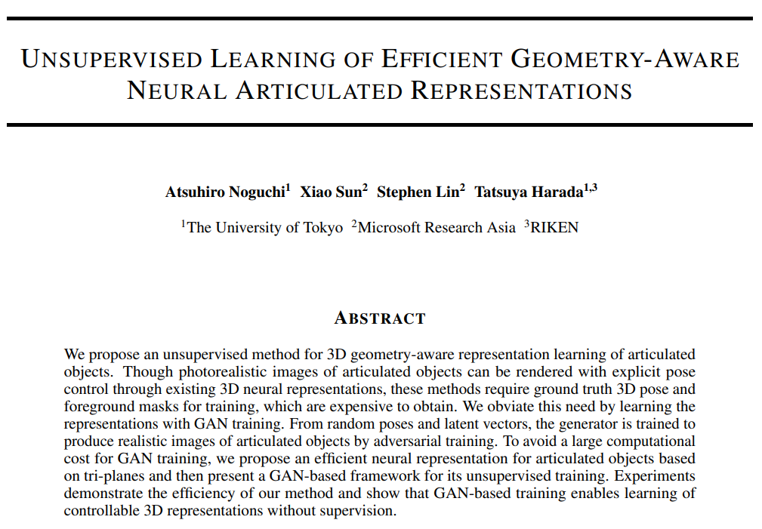
Unsupervised Learning of NARF
A novel GAN framework to learn articulated representations without using any 3D pose or mask annotation for each image.
An efficient neural representation for articulated objects based on an efficient tri-plane representation.
An efficient implementation of deformation fields using tri-planes for dynamic scene training.

Slide 16
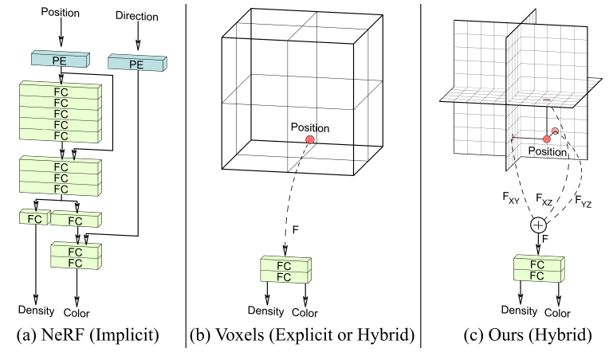
The Efficient Tri-plane Representation
(a) Neural implicit representations use fully connected layers (FC) with positional encoding (PE) to represent a scene, which can be slow to query.
(b) Explicit voxel grids or hybrid variants using small implicit decoders are fast to query but scale poorly with resolution.
(c) Our hybrid explicit–implicit tri-plane representation is fast and scales efficiently with the resolution, enabling greater detail for equal capacity.
Generated by CNN
Look-up table
Chan, Eric R., et al. "Efficient geometry-aware 3D generative adversarial networks." Proceedings of the IEEE/CVF Conference on Computer Vision and Pattern Recognition. 2022.

Slide 17
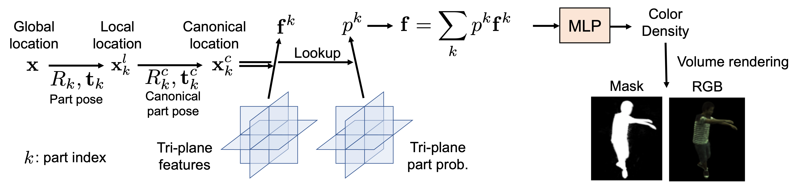
Efficient NARF Rebuilt with Tri-planes
Original NARF
Efficient NARF

Slide 18
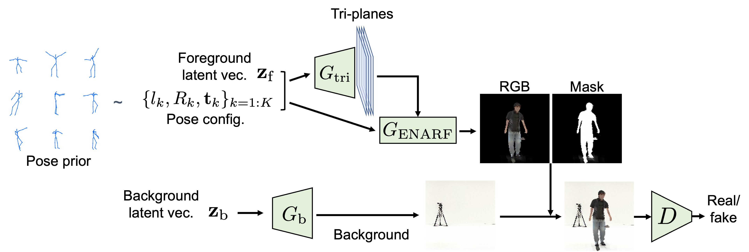
GAN Training
The Efficient NARF generator generates images of articulated objects from randomly sampled latent vectors and poses.
The network is trained by the standard adversarial objective.

Slide 19
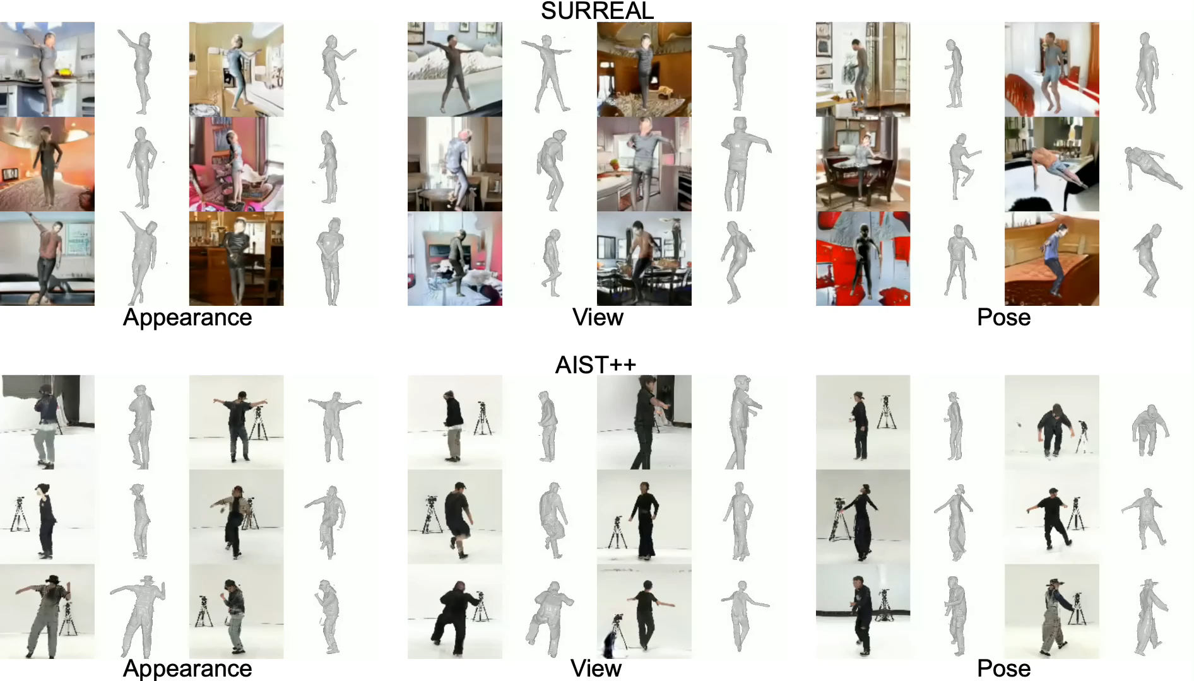
Results

Slide 20
Ablation Study on Pose Priors
 | FID↓ | FG-FID↓ | Depth↓ | PCKh@0.5 ↓
ENARF-GAN | 22.6 | 21.3 | 8.8 | 0.853
ENARF-GAN CMU pri. | 24.2 | 25.6 | 12.8 | 0.855
ENARF-GAN rand. pri. | 25.9 | 37.0 | 13.8 | 0.798
ENARF-GAN with the same pose distribution (AIST++) as the training images performs the best.
Even when using the CMU prior, we can still learn pose-controllable 3D representations with just a slight sacrifice in image quality.
When using the random prior, the plausibility of the generated images and the quality of the generated geometry drop significantly.

Slide 21
Thank You!

